Slide 1


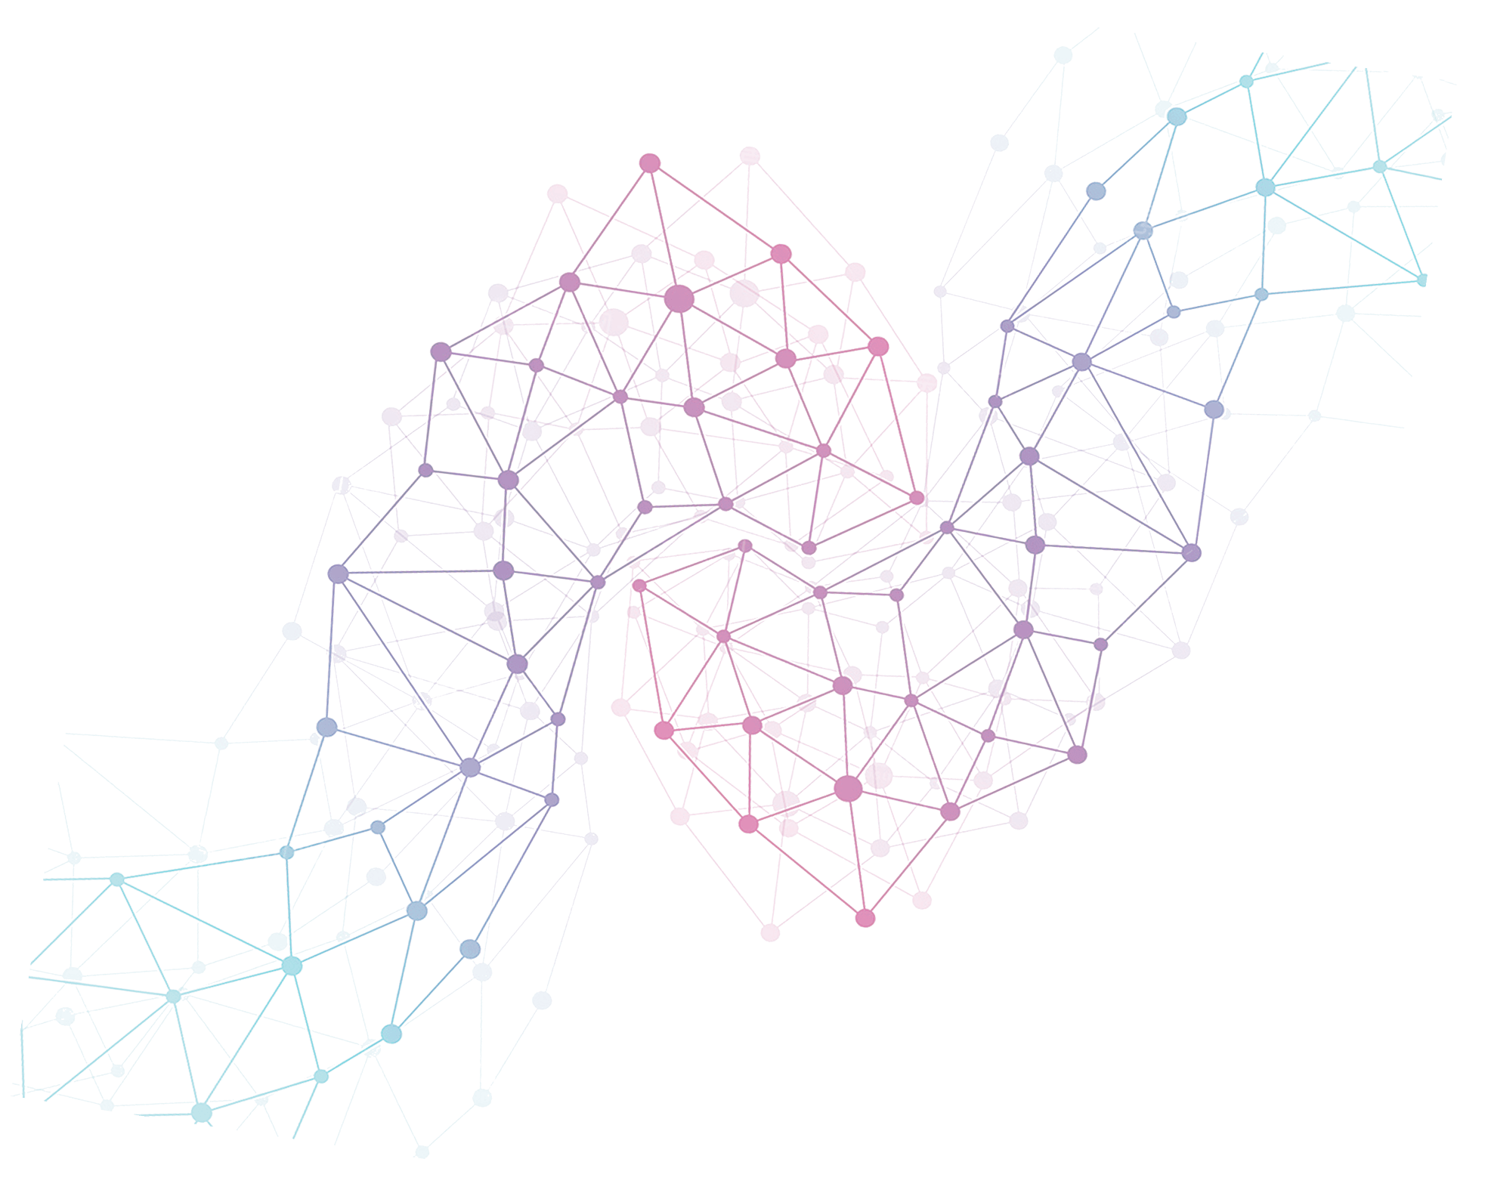



Pong Game
Yikang Lin, Joseph Tadrous, Keith Mburu

Slide 2
Team Description
Three members: Joseph Tadrous, Yikang Lin, and Keith Mburu.
Joseph: time management, dry-running, coding, and organization
Yikang: coding, presentations skills, code logic, and communication
Keith: driving code, creativity, testing code, and time management
We all have interest in exploring the use of python in games

Slide 3
Project Description
·Two players and each controls a paddle moving vertically
·Players use the paddles to hit a ball back and forth
· First person who receives 11 points wins. Points are earned when one fails to return the ball to the other
·Use pygame library.

Slide 4
Sample Pong Game
https://www.youtube.com/watch?v=it0sf4CMDeM

Slide 5
Suitability of Project
1. Cover a lot of in-class topics, including but not limited to:
·Preconditions and postconditions
·Testing for correctness, test suits, and doctest
·Conditionals, if-else, nested if-else, chain of conditionals
·Loops (while, for): nested loops
·Functions, arguments, default arguments, a keyword argument
2. Expand knowledge by learning pygame library

Slide 6
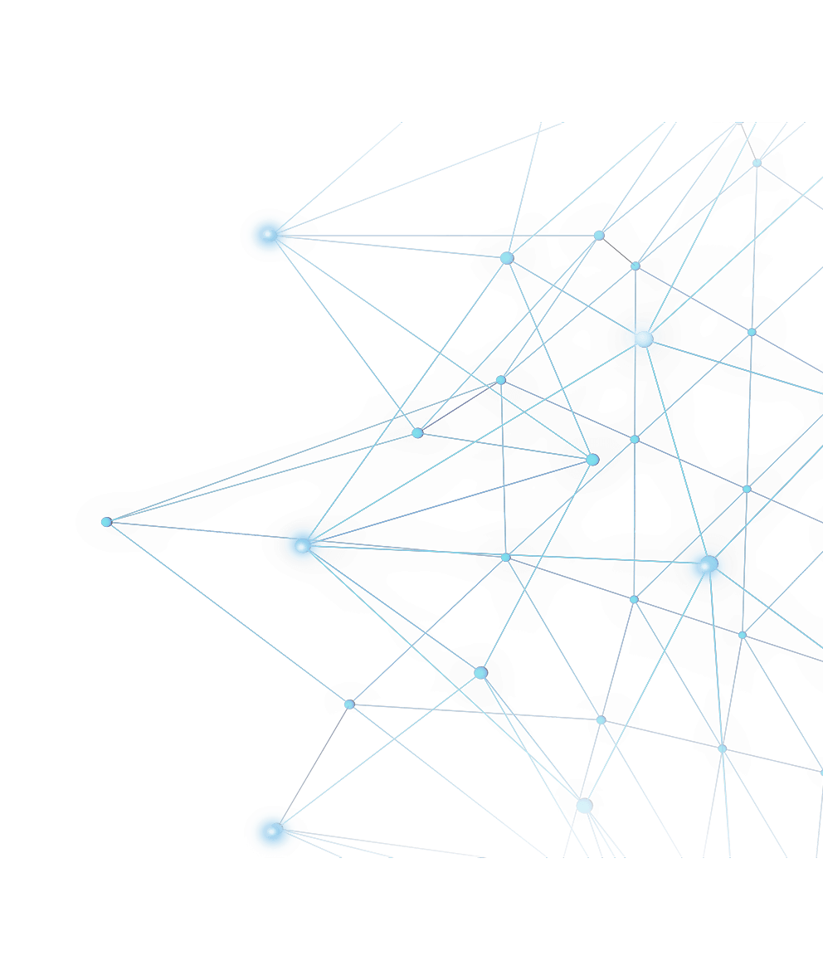

Work Timeline

Slide 7
First Week
1. Be familiar with the built-in functions of libraries of pygame and random- 2 hours (all members)
2. Learn about the ideas of class, constructor and their implementations- 2 hours (all members)
3. Start thinking about the logic of pong game, especially Ball Class- 4 hours (all members)

Slide 8
Second Week
1. Implement the Ball Class-6 hours
a. Writing constructor- 1 hour (Joseph)
b. Writing function for bounce- 1 hour (Bailey)
c. Writing function to reset the ball- 2 hours (Joseph)
d. Writing function to update the position of the ball- 2 hours (Bailey)
2. Implement the Player Class-4 hours
a. Writing constructor- 2 hours (Bailey)
b. Writing function to update the position of players (paddle)- 2 hours (Joseph)
3. Start thinking about the main code-2 hours (all members)

Slide 9
Third Week
1. Implement the main code-12 hours

Slide 10
Final Phase
1. Debugging and finalizing-3 hours (all members)
2. Rehearse for the final presentation-2~3 hours (all members)

Slide 11
Potential Challenges
· Relatively long period of time to be familiar with pygame functions and their usage
· Object oriented programming: using functions written in a class

Slide 12
Thank you!

